Slide 1
TEAM 06
Presentation by
Chiranjeet Banerjee
Riya Singh
USA House Prediction

Slide 2
What would we achieve by doing this
The goal of this project is to leverage the extensive dataset from Craigslist to develop predictive models for housing prices. By applying machine learning algorithms to this dataset, we aim to extract valuable insights that can enhance our understanding of housing market dynamics across different states.

Slide 3
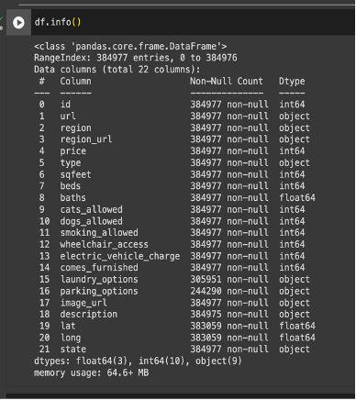
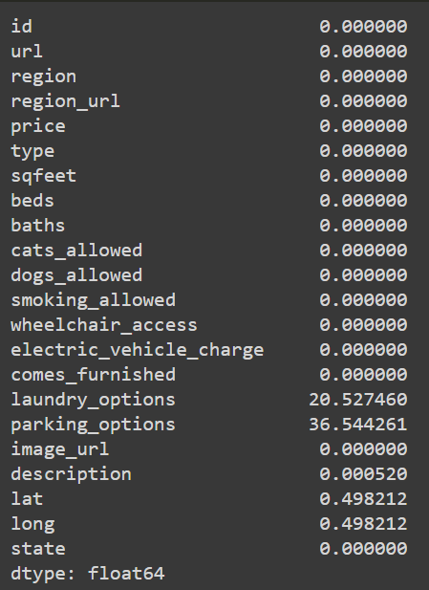
Getting an overview of the
dataset
Our dataset is extracted from Craigslist and
contains information about various factors
that are considered when pricing a houses.
Since the dataset is huge, firstly we clean
the dataset

Slide 4
Why clean the data?
Imagine feeding a messy pile of ingredients to a chef. It would be difficult, if not impossible, to create a delicious meal. Similarly, feeding an uncleaned dataset to a machine learning model leads to unreliable results.
Data Preprocessing and Cleaning
Improves Accuracy,Boosts Performance,Enables Efficient Modeling
Missing Values
Outlier Detection
Removing duplicates and irrelevant columns
After completing this process we now move on to understand the data and how different columns have an impact on the target variable and their correlation.

Slide 5
Analyzing the dataset
Analyzing the dataset provided insights into its composition, comprising categorical, continuous, and textual variables. Through visualization, we explore the relationships between these variables and their potential impact on the target variable.
Categorical variables
Relation between type and price?
Effect of parking options on house price prediction?
How are cats allowed and dogs allowed values affecting the price?
How important is wheel access ,smoking_allowed,electric_vehicle_charge,comes_furnished
Effect of laundry options on price?
Continuous variables
Effects of beds and bath on house price
Relation between sqfeet and price
Relationship of similar looking columns :Region and state

Slide 6
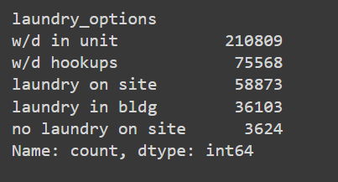
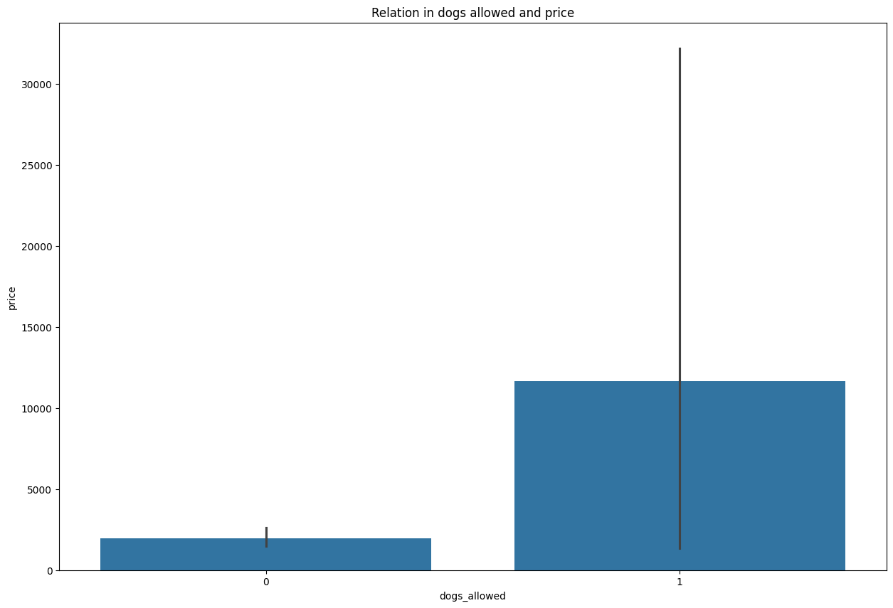
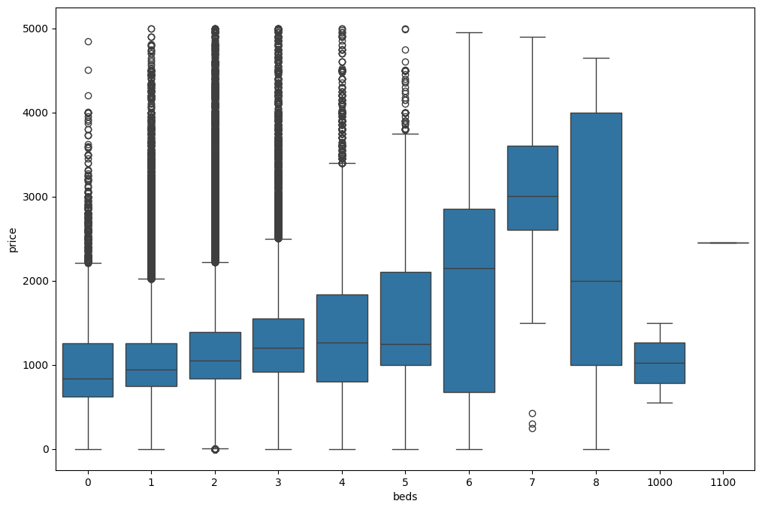
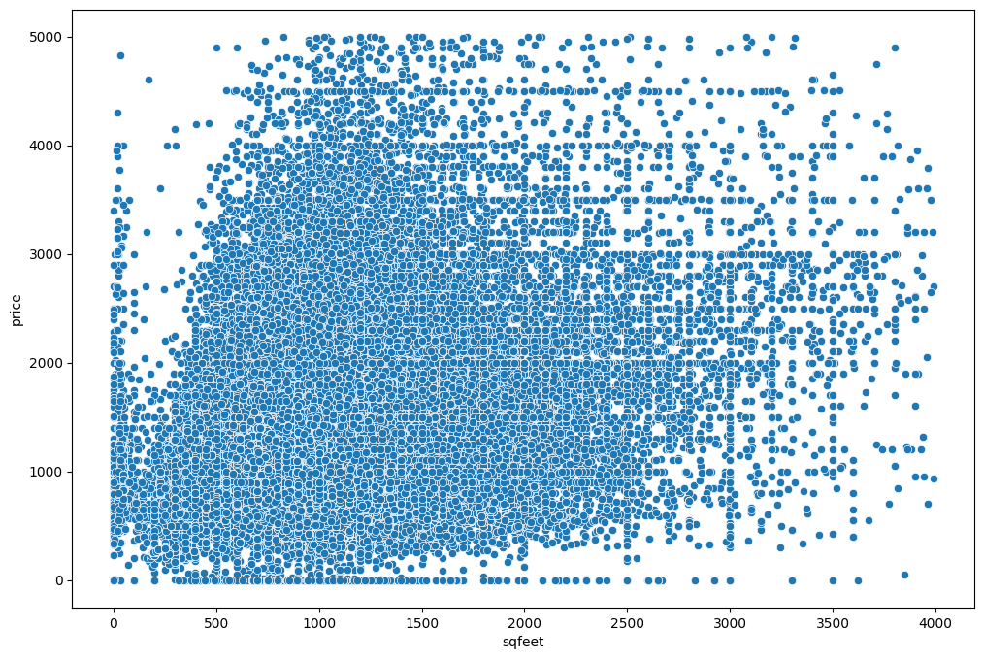
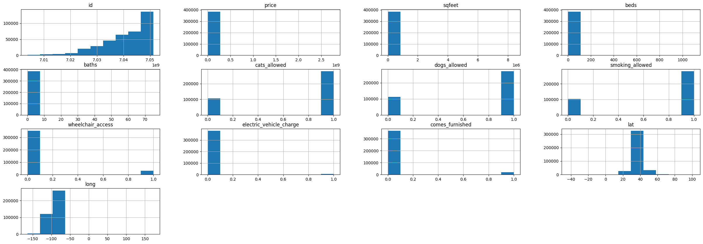
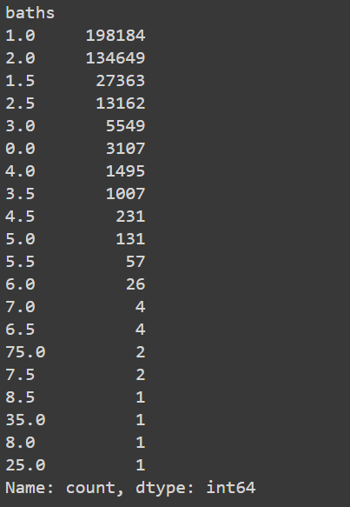
Effect of laundry options on price
How are cats allowed affecting the price?
Effects bed on house price
Relation between sqfeet and price
Effects bath on house price
Histogram :Overall dataset

Slide 7
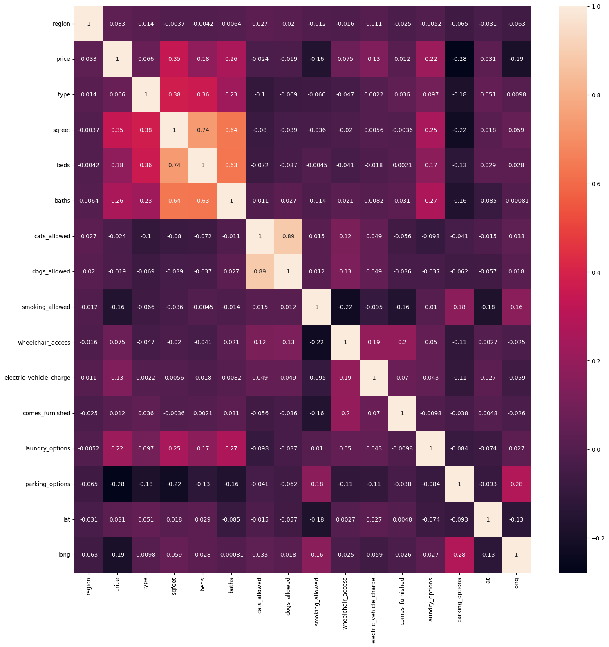
What about multicollinearity
No strong correlations:
There were no dark red or dark blue squares in the off-diagonal elements, which indicated strong positive or strongother, which is a desirable condition for regression analysis and other statistical modeling techniques.
negative correlations, respectively.
We inferred that there is no evidence of severe multicollinearity in this dataset. The absence of strong correlations between pairs of variables suggests that the independent variables are relatively uncorrelated with each

Slide 8
What did we learn???
Hence now that we have analyzed the dataset, understood their relationships and correlations with target variable, how these values are affecting the house predictions and their relationship among themselves we can now further proceed to do feature engineering of the dataset.

Slide 9
Feature Engineering
Now we would be transforming existing features to improve the performance of machine learning models.
We will compare many different columns like sq feet, price, region, and state to see which when combined will help us predict the house listings more accurately.
The goal is to extract relevant information from the raw data and create input features that enhance the predictive power of the models.

Slide 10
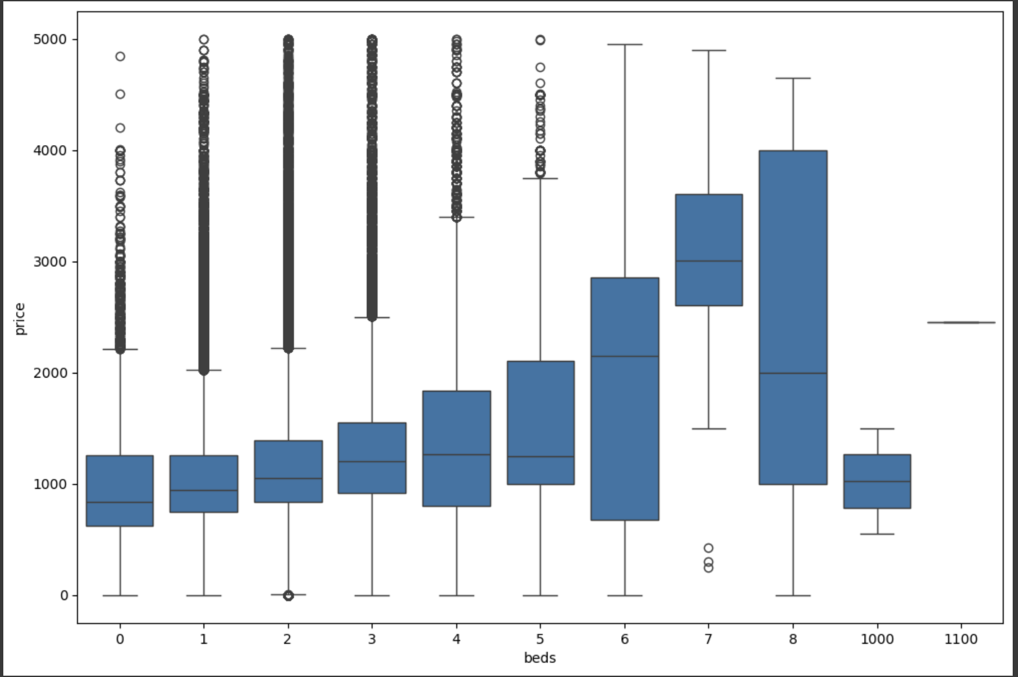
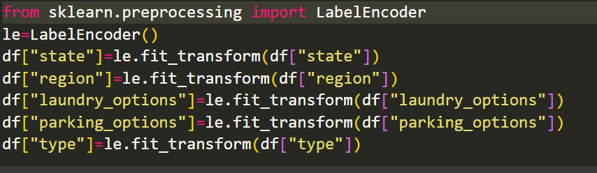
How to improve the dataset
Combining Columns
Removing noisy data and outliers
Dropping similar columns
Label encoding

Slide 11
NEXT STEP …
Split the dataset to train and test :
from sklearn.model_selection import train_test_split
X_train, X_test, y_train, y_test = train_test_split(x,y, test_size = 0.2, random_state = 0)
EXPLORING ML MODELS :
Linear Regression
Gradient Boosting
XGBoosting
Random Forest

Slide 12
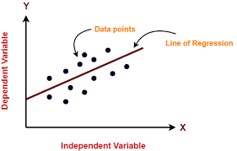
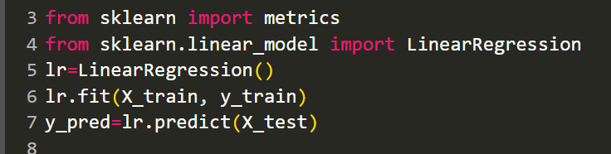
LINEAR REGRESSION

Slide 13
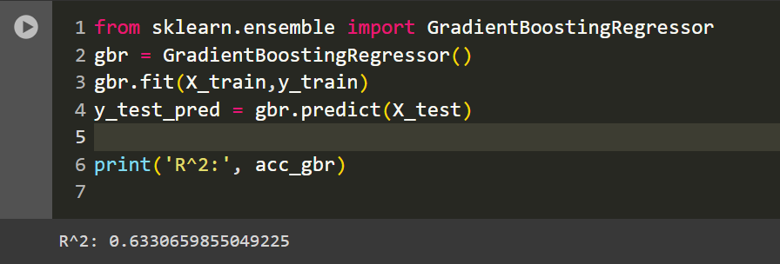
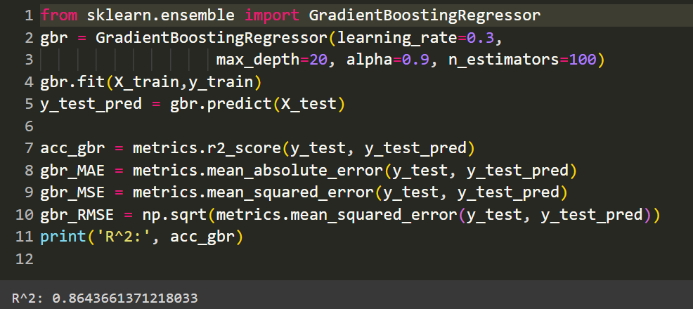
Gradient boosting (hyper-parameter tuning included)

Slide 14
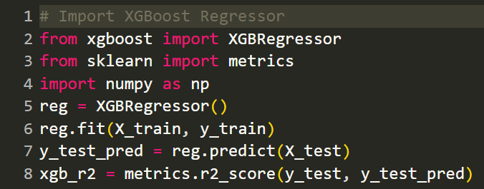
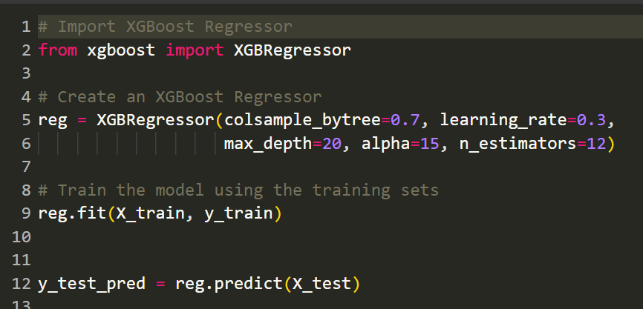
XGBOOSTING (hyper-parameter tuning included)

Slide 15
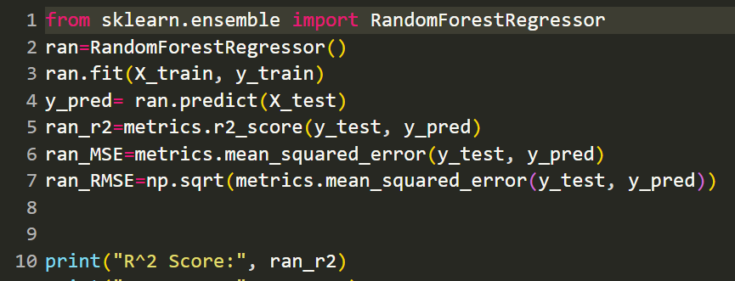

Random Forest Algorithm

Slide 16
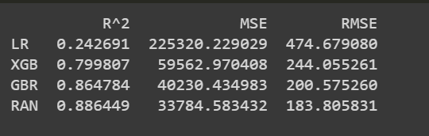
Did we find the best performing Model ?
1. Random Forest (RAN) demonstrates superior
performance with highest R^2, lowest MSE, and
RMSE, followed by Gradient Boosting Regression &
XGBoosting (XGB), while Linear Regression (LR)
shows the least suitability.
2. Thus, prioritize using Random Forest (RAN) or
Gradient Boosting Regression (GBR)
for optimal predictive performance in this scenario.

Slide 17
Learnings
Overall, our project underscores the importance of data preprocessing, feature engineering, and algorithm selection in building accurate regression models for house price prediction.
In the future we can try to run models like PCA,SVM to analyze which model could perform better.

Slide 18
THANK YOU

